Slide 1

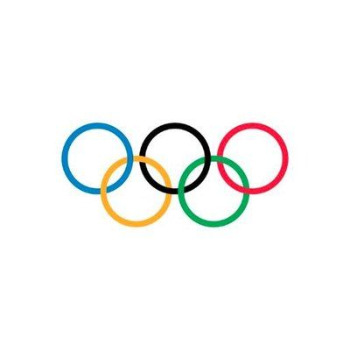
OLYMPICS CASE STUDY
A Research Project by ALI AHMAD

Slide 2
CONTENTS
CASE STUDY
OBJECTIVES
DATA ANALYSIS
IMPORTANT FACTORS
FINDINGS

Slide 3
CASE STUDY
This case study consists of 2 data sets.
The first dataset consists of athlete and events details in different cities and countries mentioning their Sex, Age, Team, Sports they played, Medal attained the athletes, etc. There are total of 15 features.
The second dataset contains the Noc (National Olympic Committee) and the country name.

Slide 4
OBJECTIVES
Analyse how the Olympics have evolved over time for female, analysis about the participation and performance of athletes based on different nations, and different sports and events, athletes who won medals and how the growth of women participation evolved in Olympics over time.
Analyse which country has the highest number of participants, team which has the highest number of medals and the most popular sports among men and women.
Publish the findings based on data analysis.

Slide 5
Data Analysis
For analysing the data, various factors affecting the business(i.e. the important attributes) should be listed out.
In this case study, there are 2 tables athlete_events (consisting of athlete and the event details with 271116 rows) and noc_regions (consisting Noc and region in which the event will take place).

Slide 6
Important factors forming a general trend among the athletes
Athlete’s Gender
Medals attained by various athletes
Age of athletes
Team
Female athletes participation evolution in olympics
Season (Summer or Winter)
City (suitable for multiple games)
Sport (Most popular among Men and Women)
Height and Weight distribution of the different athletes

Slide 7
Table Analysis
This dataset consists of 2 tables.
This dataset consists of athletes and the events they are taking part in the Olympics.
The second dataset consists of 207 different regions which are taking part in the Olympics.

Slide 8
Male And Female participation in Olympics
The number of male athletes participating in the Olympics are more.
Whereas the number of female athletes are significantly low as compared to male

Slide 9
Male and Female Participation By City Wise

Slide 10
Medals Attained in Olympics

Slide 11
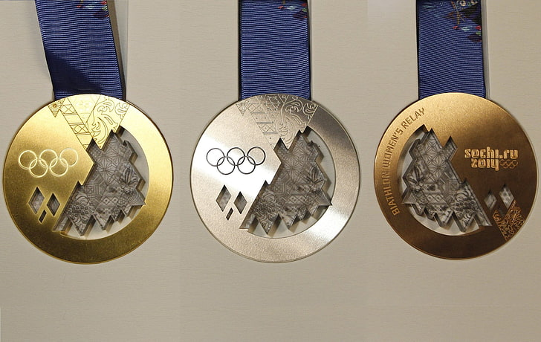
Medals Attained by Athletes
As per the visualisation, number of Medals won by male athletes for Gold, Silver and Bronze are comparatively higher than the female athletes.
We can also see in the visualisation that there are high number of males as well as female athletes with No Medal.

Slide 12
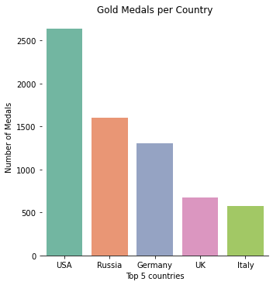

Slide 13
Top 5 Countries with Gold Medals
USA has won the highest number of Gold medals (2638) in Olympics followed by Russia with 1599 Gold medals and Germany having the third highest number of Gold medals (1301).

Slide 14
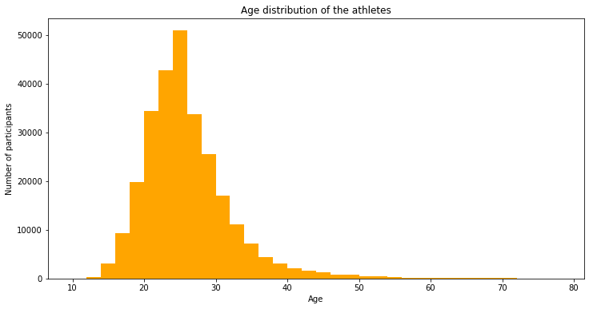
AGE DISTRIBUTION

Slide 15
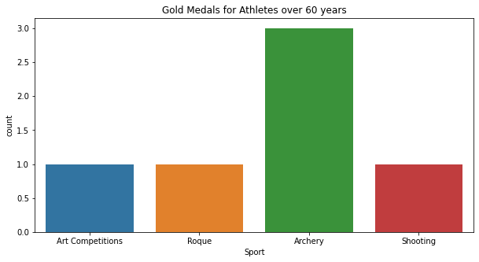
Age of participants beyond 60 years
As per visualisation, athletes participating in Archery have 3 Gold medals.
For athletes participating in Shooting, Art Competitions and Roque have only 1 Gold medal each.

Slide 17
Team that has the highest number of participants
The above bar chart shows the top 10 countries according to the number of participants. The USA has the highest number of participants followed by France with the second highest number of participants. Hungary has the least number of participants.

Slide 19
Team with the highest number of medals
The above bar graph shows the 10 countries with the highest number of medals.
United States has won the highest medal in Olympics. It has won more than 4000 medals whereas other countries like Great Britain and Germany have won almost 2000 medal which is half of the United States’ medal.

Slide 20
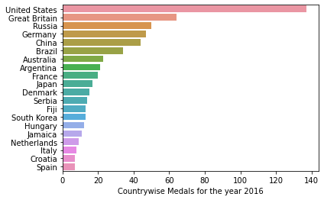
Medal Attained in Rio Olympics 2016
As we can see, in the Rio Olympics 2016, the highest number of medals were won by United States followed by Great Britain and Russia.
Least performing countries were Italy, Croatia and Spain at the bottom.

Slide 21
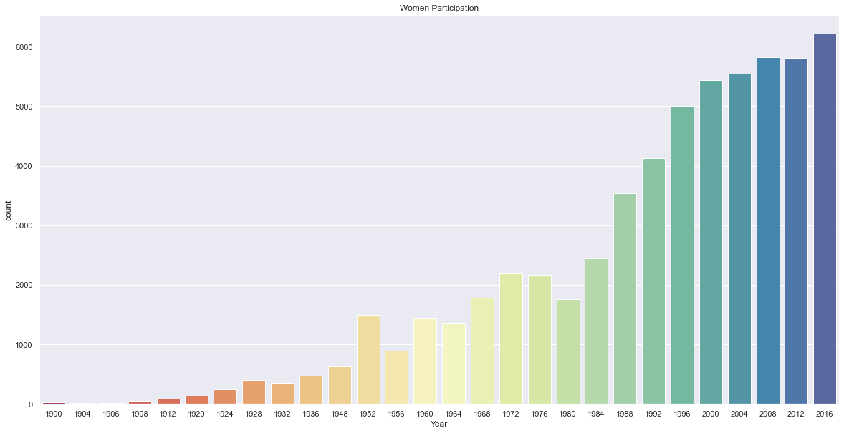
Female Athletes in Olympics

Slide 22
Number of Female Athletes in Olympics
1900
As per the visualization, we can see in the year 1900 that participation of women athletes was very low as compared to the year 2016 where more than 6000 women participated.
2016
The general trend for women participation was seen escalating from the year 1900 t0 2016

Slide 23
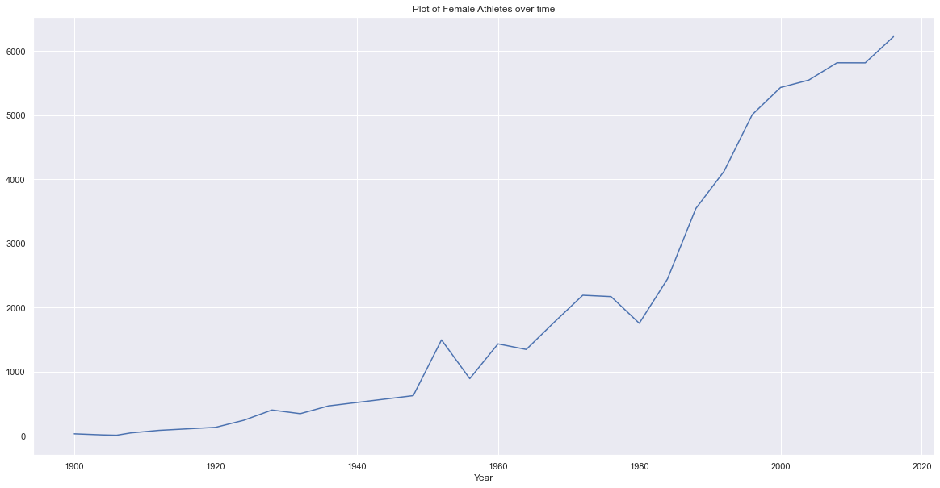
General Trend for Female Athletes

Slide 24
Seasons
In 1986, it was decided to separate the Summer and Winter Games.
So, the number of athletes participating in the Summer Olympics are more whereas the number of athletes are significantly low in the Winter Olympics .

Slide 26
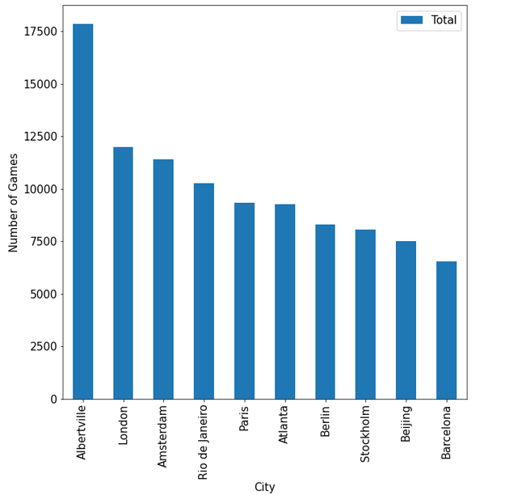
Most suitable City for Olympic Games
The bar graph shows the top 10 cities with the highest number of games played.
Albertville is the most suitable city for playing games followed by London.

Slide 27
Popular Sports for Women

Slide 28
Popular Sports for Men

Slide 29
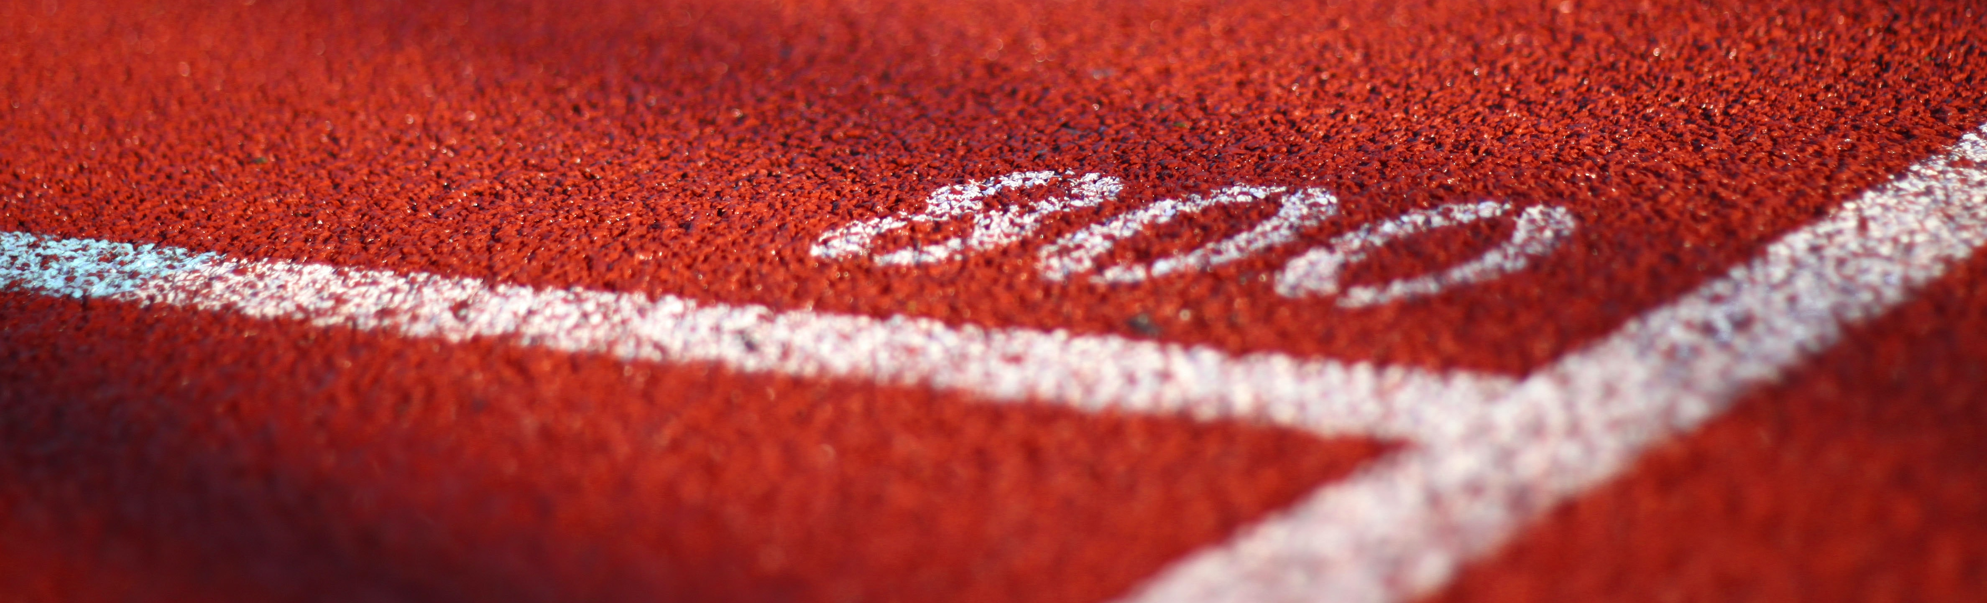
Popular Sports among Men and Women
Football and Hockey have most participant. Most of the games we see are team games. However, we do see some individual events such as cycling, gymnastics and marathon among the top 10 popular sports for men.
For women, Volleyball and Hockey are popular team sports. Gymnastics is apparently most popular individual event.

Slide 31
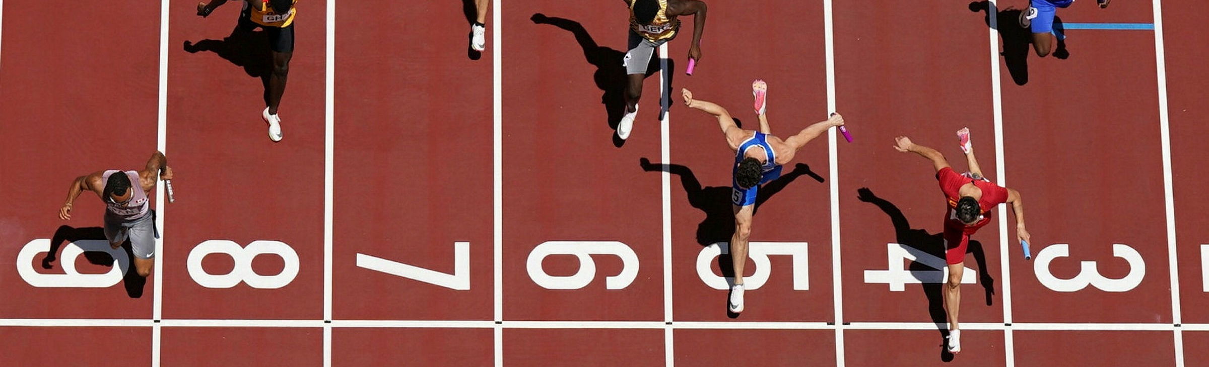
Number of participants in each sport
The above graph shows the top 10 sports with the highest number of participants in the Olympics.
Athletics has the highest number of participation followed by Gymnastics and Swimming. Wrestling had least number of participation as compared to other sports.

Slide 32
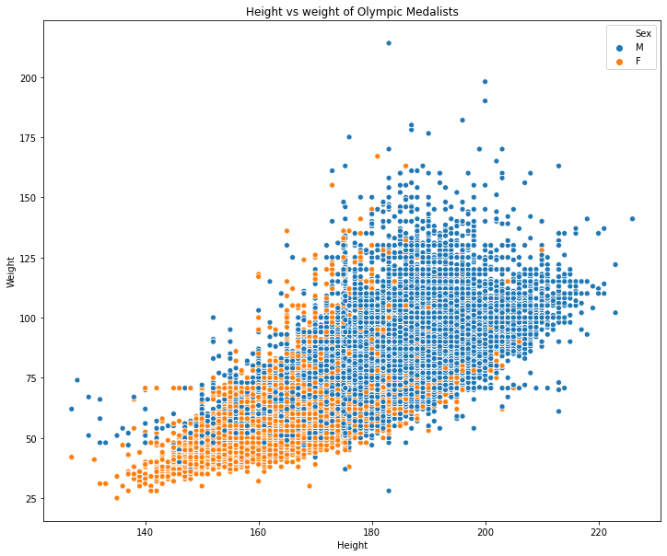
Height and Weight Distribution for Men and Women

Slide 33
Findings
United States has won most Olympic medals.
The analysis shows, in the Olympics, participation of men is always higher in comparison to women athletes, but women participation is increasing continuously.
The analysis shows, Football and Hockey is popular among men while whereas a lot of women athletes choose Volleyball & Gymnastics.
Age of participants beyond 60 years are also participating in the Olympics.
Based on Season, number of athletes are seen more in Summer while less in Winter.
United States has the highest number of participants in the Olympics
Most suitable city for playing games was Albertville.

Slide 34
THANK YOU

